Slide 1
Support Vector Machines

Slide 2
Contents

Slide 3
Contents
Introduction
The decision boundary with largest margin
SVM- The large margin classifier
SVM algorithm
The kernel trick
Building SVM model
Conclusion

Slide 4
Introduction

Slide 5

Introduction
SVM is another black box method in Machine Learning space
Compared to other ml algorithms, SVM totally a different approach to learning.
The in-depth theory and mathematics of SVM needs great knowledge
in vector algebra and numerical analysis
We will try to learn the basic principal, philosophy, implementation of SVM
SVM was first introduced by Vapnik and Chervonenkis
Neural networks try to reduce the squared error and often suffer from
overfitting.
SVM algorithm has better generalization ability. There are many applications where SVM works better than neural networks

Slide 6
The Classifier

Slide 7
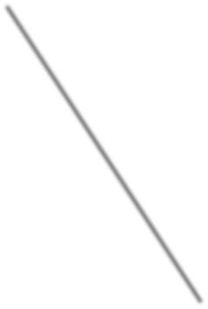
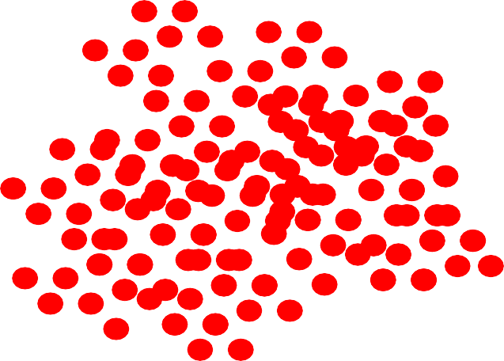
The Classifier
To understand the SVM algorithm easily, we will start with the decision boundary
The line or margin that separates the
classes
Classification algorithms are all about
x2
finding the decision boundaries
A good classifier is the one that generalizes well. It should work well on both training and testing data
It need not be a straight line always
x1

Slide 8
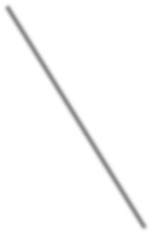

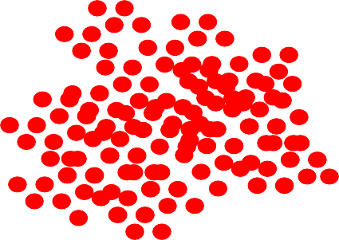
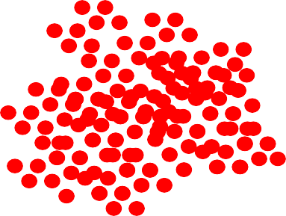
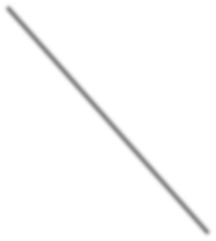

Many Classifiers
There can be many classifiers. That may work for a given dataset.
They might even have same level of accuracy
How to choose the best
classifier ?
x2
x2
x1
x1
x2
x1

Slide 9
The Margin of classifier

Slide 10

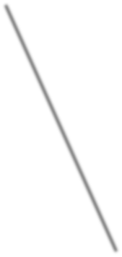

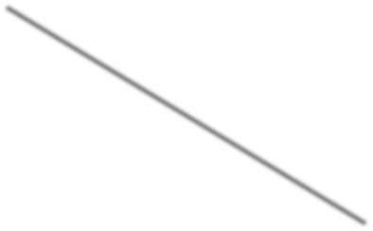


The margin of classifier
x2
x2
x1
x1
Out all the classifiers, the one that has maximum margin will generalize well. But why?

Slide 11
The best decision boundary
x2
x2
x1
x1
Out all the classifiers, the one that has maximum margin will generalize well. But why?
Imagine two more data points. The classifier with maximum margin will be able to classify them more accurately.

Slide 12
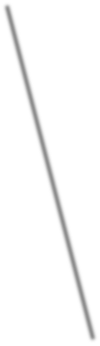
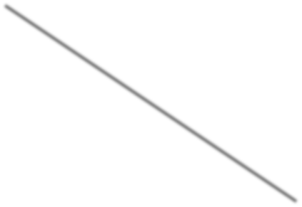
The Maximum Margin Classifier
So, the best classifier has maximum margin
The classifier that maximizes the distance between itself and the nearest training data
In our example a,b,c are the training data points that are near to m1, and a,c,d are the training examples that are near to model m2.
The model m1 has maximum margin
The model m1 works well with the unseen examples
The model m1 does good generalization
For a given dataset, if we can find a classifier that has maximum margin, then it will assure maximum accuracy.
m1
m2
x2
c
a
d
b
x1

Slide 13
LAB: Simple Classifiers

Slide 14
LAB: Simple Classifiers
Dataset: Fraud Transaction/Transactions_sample.csv
Draw a classification graph that shows all the classes
Build a logistic regression classifier
Draw the classifier on the data plot

Slide 15
SVM- The large margin
classifier

Slide 16
SVM- The large margin classifier
SVM is all about finding the maximum-margin Classifier.
Classifier is a generic name, its actually called the hyper plane
Hyper plane: In 3-dimensional system hyperplanes are the 2-dimensional planes, in 2- dimensional space its hyperplanes are the 1-dimensional lines.
SVM algorithm makes use of the nearest training examples to derive the classifier
with maximum margin
Each data point is considered as a p-dimensional vector (a list of p numbers)
SVM uses vector algebra and mathematical optimization to find the optimal
hyperplane that has maximum margin

Slide 17
The SVM Algorithm

Slide 18

The SVM Algorithm
If a dataset is linearly separable then we
can always find a hyperplane f(x) such that
For all negative labeled records f(x)<0
For all positive labeled records f(x)>0
This hyper plane f(x) is nothing but the linear classifier
• f(x)=w₁x₁+ w₂x₂ +b
f(x)=w^{T}x+b
x2
c
a
d
b
x1

Slide 19

The SVM Algorithm
Given that plane, we can calculate the distance between each data vector(point)
x2
c
a
d
b
x1

Slide 20
The SVM Algorithm
Some points on the edges are close to the hyperplane
The distance between these points and the hyperplane is known as margin of the classifier
x2
c
a
d
b
x1

Slide 21
The SVM Algorithm
All those data points(vectors) that are on the edge, that constitute to the margin of classifier are called support vectors
Vectors a, b & c are support vectors
Based on these hyperplane with maximum
margin will be calculated
x2
c
a
d
b
x1

Slide 22
SVM Result

Slide 23
SVM Result
SVM doesn’t output probability. It directly gives which class the new data point
belongs to
For a new point x_{k} calculate w^{T}x_{k}+b. If this value is positive then the prediction is +1 else -1

Slide 24
SVM on R

Slide 25
SVM on R
There are multiple SVM packages available in R. The package “e1071” is the most
widely used
There is a function called svm() within e1071 package
There are various options within svm() function to customize the training process
svm_model <- svm(Fraud_id~Total_Amount+Tr_Count_week, data=Transactions_sample)
summary(svm_model)

Slide 26
LAB: First SVM Learning Problem
Dataset: Fraud Transaction/Transactions_sample.csv
Draw a classification graph that shows all the classes
Build a SVM classifier
Draw the classifier on the data plots
Predict the (Fraud vs not-Fraud) class for the data points Total_Amount=11000,
Tr_Count_week=15 & Total_Amount=2000, Tr_Count_week=4
Download the complete Dataset: Fraud Transaction/Transaction.csv
Draw a classification graph that shows all the classes
Build a SVM classifier
Draw the classifier on the data plots

Slide 27
The Non-Linear Decision
boundary

Slide 28
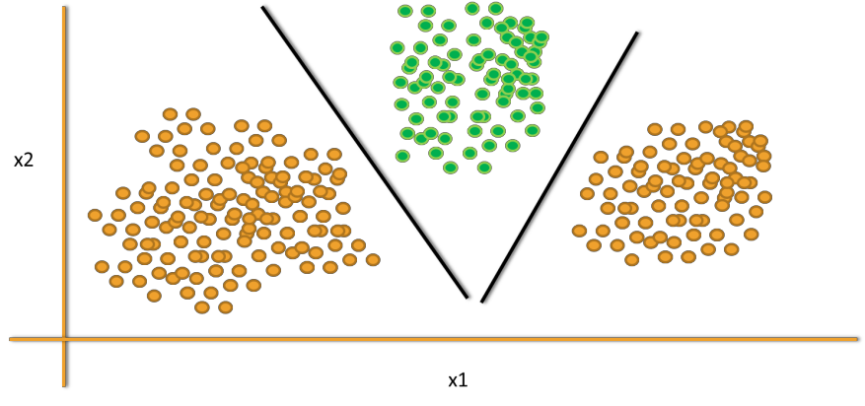
The Non-Linear Decision boundary
In the above examples we can clearly see the decision boundary is linear
SVM works well when the data points are linearly separable
If the decision boundary is non-liner then SVM may struggle to classify
Observe the below examples, the classes are not linearly separable
SVM has no direct theory to set the non-liner decision boundary models.
m1
m2
x1

Slide 29
Mapping to higher dimensional space
The original maximum-margin hyperplane algorithm proposed by Vapnik in 1963
constructed a linear classifier.
To fit a non liner boundary classier, we can create new variables(dimensions) in the data and see whether the decision boundary is linear.
in 1992, Bernhard E. Boser, Isabelle M. Guyon and Vladimir N. Vapnik suggested a
way to create nonlinear classifiers by applying the kernel trick

Slide 30
Mapping to higher dimensional space
In the below example, A single linear classifier is not sufficient
lets create a new variable x2=(x1)^2. In the higher dimensional space
We can clearly see a possibility of single linear decision boundary
This is called kernel trick
m1
m2
x2
φ(x)=(x,x²)
x1
x1

Slide 31
Kernel Trick

Slide 32
Kernel Trick
We used a function φ(x)=(x,x^2) to transform the data x into a higher dimensional space.
In the higher dimensional space, we could easily fit a liner decision boundary.
This function φ(x) is known as kernel function and this process is known as kernel trick in SVM
φ( )φ( )
φ( )
φ( ) _{φ( )}
φ( )
φ( )φ( )
φ(x)
φ( ) _{φ( )}
φ( )
_{φ}φ₍( ₎)
φ( )
φ( )

Slide 33
Kernel Trick
Kernel trick solves the non-linear decision boundary problem much like the hidden layers in neural networks.
Kernel trick is simply increasing the number of dimensions. It is to make the non-linear decision boundary in lower dimensional space as a linear decision boundary, in higher dimensional space.
In simple words, Kernel trick makes the non-linear decision boundary to linear (in higher dimensional space)
φ( )φ( )
φ( )
φ( ) _{φ( )}
φ( )
φ( )φ( )
φ(x)
φ( ) _{φ( )}
φ( )
_{φ}φ₍( ₎)
φ( )
φ( )

Slide 34

Kernel Trick
A non-linear decision boundary in single dimensional space is mapped on to a two dimensional space using kernel function φ(x)=(x,x²)
m1
m2
x2
x1
x1
A non-linear decision boundary in two dimensional space is mapped on to a three dimensional space using kernel function
φ(x1,x2)=(x₁ ,x₂ ,√2x₁x₂)
2 2

Slide 35
Kernel Function Examples
Name | Function | Type problem
Polynomial Kernel | (𝒙^{𝒕}𝒙 + 𝟏)^{𝒒} q is degree of polynomial 𝒊 𝒋 | Best for Image processing
Sigmoid Kernel | 𝒕𝒂𝒏𝒉(𝒂𝒙^{𝒕}𝒙 + 𝒌) k is offset value 𝒊 𝒋 | Very similar to neural network
Gaussian Kernel | _{𝒆}||𝒙_{𝒊}−𝒙_{𝒋}||^{𝟐}/𝟐𝝈^{𝟐} | No prior knowledge on data
Linear Kernel | 𝟑 (𝒙_{𝒊}+𝒙_{𝒋}) _{𝟐} 𝒎𝒊𝒏 𝒙_{𝒊}, 𝒙_{𝒋} 𝟏 + 𝒙_{𝒊}𝒙_{𝒋}𝒎𝒊𝒏 𝒙_{𝒊}, 𝒙_{𝒋} − _{𝟐} 𝒎𝒊𝒏 𝒙_{𝒊}, 𝒙_{𝒋} + _{𝟑} | Text Classification
Laplace Radial Basis Function (RBF) | _{𝒆}−𝜸||𝒙_{𝒊}−𝒙_{𝒋}|| _{, 𝜸 ≥ 𝟎} | No prior knowledge on data
There are many more kernel functions.

Slide 36
Choosing the Kernel Function
Probably the most tricky part of using SVM.
The kernel function is important because it creates the kernel matrix, which summarizes all the data
There is no proven theory for choosing a kernel function for any given problem. Still
there is lot of research going on.
In practice, a low degree polynomial kernel or RBF kernel with a reasonable width is a good initial try
Choosing Kernel function is similar to choosing number of hidden layers in neural
networks. Both of them have no proven theory to arrive at a standard value.
As a first step, we can choose low degree polynomial or radial basis function or one of those from the list

Slide 37
LAB: Kernel – Non linear
classifier

Slide 38
LAB: Kernel – Non linear classifier
Dataset : Software users/sw_user_profile.csv
How many variables are there in software user profile data?
Plot the active users against and check weather the relation between age and “Active” status is linear or non-linear
Build an SVM model(model-1), make sure that there is no kernel or the kernel is linear
For model-1, create the confusion matrix and find out the accuracy
Create a new variable. By using the polynomial kernel
Build an SVM model(model-2), with the new data mapped on to higher dimensions. Keep the default kernel in R as linear
For model-2, create the confusion matrix and find out the accuracy
Plot the SVM with results.
With the original data re-cerate the model(model-3) and let R choose the default kernel function.
What is the accuracy of model-3?

Slide 39
Code: Kernel – Non linear classifier
sw_user_profile$age_nor<-(sw_user_profile$Age-
mean(sw_user_profile$Age))/sd(sw_user_profile$Age)
plot(sw_user_profile$age_nor,sw_user_profile$Id, col=as.integer(sw_user_profile$Active+1))
#Creating the new variable
sw_user_profile$new<-(sw_user_profile$age_nor)^2 plot(sw_user_profile$Age,sw_user_profile$new, col=as.integer(sw_user_profile$Active+1))
#Model Building with new variable library(e1071)
svm_model_2 <- svm(Active~Age+new, type="C", summary(svm_model_2)
kernel="linear", data=sw_user_profile)
#Confusion Matrix
library(caret)
Age_predicted<-predict(svm_model_2) confusionMatrix(Age_predicted,sw_user_profile$Active)
#Plotting SVM Classification graph plot(svm_model_2, sw_user_profile,new~Age )

Slide 40
Code: Kernel – Non linear classifier
########Model Building with radial kernel library(e1071)
svm_model_3 <- svm(Active~Age, type="C", summary(svm_model_3)
function
data=sw_user_profile)
#Confusion Matrix library(caret)
Age_predicted<-predict(svm_model_3) confusionMatrix(Age_predicted,sw_user_profile$Active)
#Plotting SVM Clasification graph
plot(svm_model_3,sw_user_profile)

Slide 41
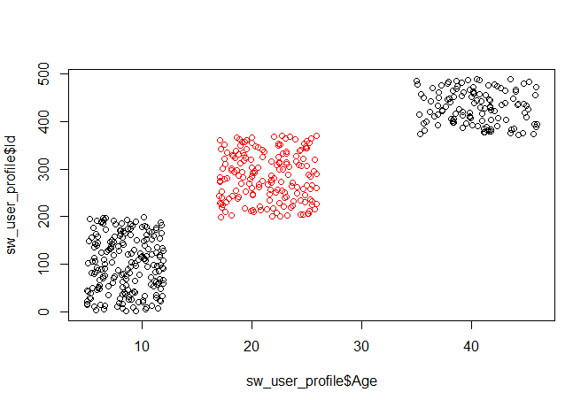
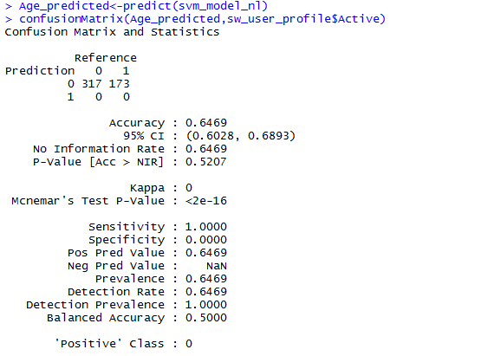
Output: Kernel – Non linear classifier

Slide 42
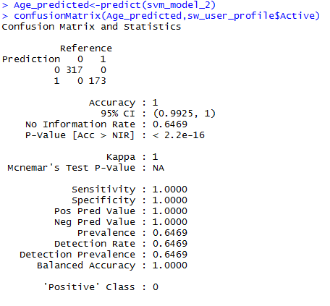
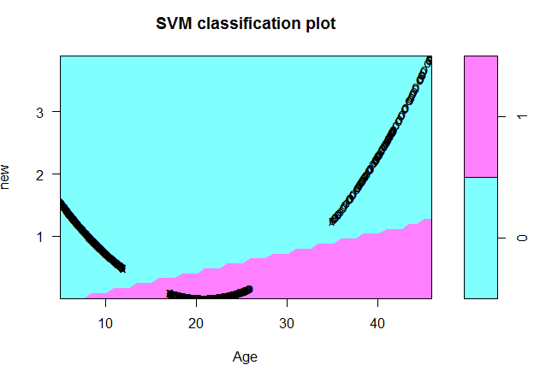
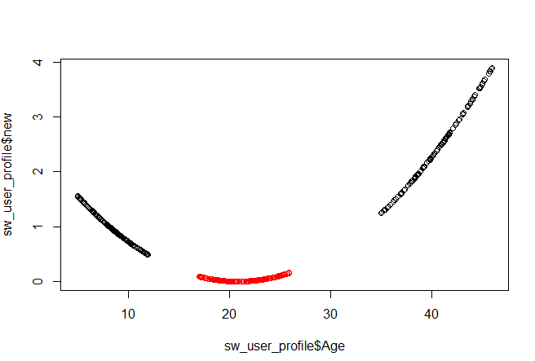
Output: Kernel – Non linear classifier

Slide 43
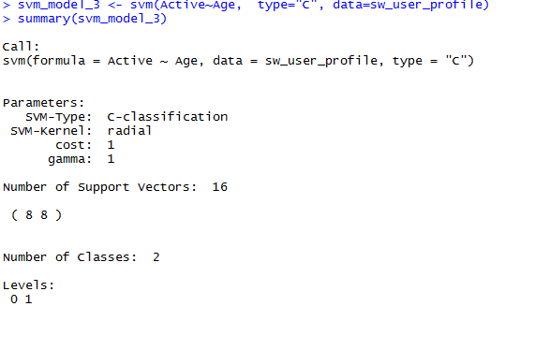
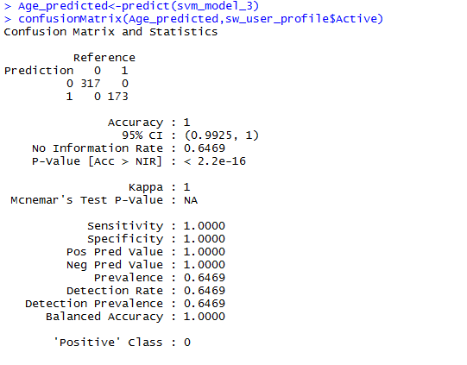
Output: Kernel – Non linear classifier

Slide 44
Soft Margin Classification –
Noisy data

Slide 45
Noisy data
What if there is some noise in the data.
What id the overall data can be classified perfectly except few points.
How to find the hyperplane when few points are
on the wrong side.
x2
c
a
d
b
x1

Slide 46

Soft Margin Classification – Noisy data
The non-separable cases can be solved by allowing a slack variable(ξ) for the point on the wrong side.
We are allowing some errors while building the
classifier
In SVM optimization problem we are initially adding some error and then finding the hyperplane
SVM will find the maximum margin classifier
allowing some minimum error due to noise.
Hard Margin -Classifying all data points correctly,
Soft margin - Allowing some error
x2
ξ₁
c
a
d
ξ₂
b
x1

Slide 47
SVM Validation

Slide 48
SVM Validation
SVM doesn’t give us the probability, it directly gives us the resultant classes
Usual methods of validation like sensitivity, specificity, cross validation, ROC and AUC will are the validation methods

Slide 49
SVM Advantages &
Disadvantages

Slide 50
SVM Advantages
SVM’s are very good when we have no idea on the data
Works well with even unstructured and semi structured data like text, Images and trees.
The kernel trick is real strength of SVM. With an appropriate kernel function, we can
solve any complex problem
Unlike in neural networks, SVM is not solved for local optima.
It scales relatively well to high dimensional data
SVM models have generalization in practice, the risk of overfitting is less in SVM.

Slide 51
SVM Disadvantages
Choosing a “good” kernel function is not easy.
long training time o large datasets
Difficult to understand and interpret the final model, variable weights and individual impact
Since the final model is not so easy to see, we can not do small calibrations to the
model hence its tough to incorporate our business logic

Slide 52
SVM Application

Slide 53
SVM Application
Protein Structure Prediction
Intrusion Detection
Handwriting Recognition
Detecting Steganography in digital images
Breast Cancer Diagnosis

Slide 54
LAB: Digit Recognition using
SVM

Slide 55



LAB: Digit Recognition using SVM
Take an image of a handwritten single digit, and determine what that digit is.
Normalized handwritten digits, automatically scanned from envelopes by the U.S. Postal Service. The original scanned digits are binary and of different sizes and orientations; the images here have been de slanted and size normalized, resultingin 16 x 16 grayscale images (Le Cun et al., 1990).
The data are in two gzipped files, and each line consists of the digitid (0-9) followed
by the 256 grayscale values.
Build an SVM model that can be used as the digit recognizer
Use the test dataset to validate the true classification power of the model
What is the final accuracy of the model?

Slide 56
Code: Digit Recognition using SVM
#Importing test and training data
digits_train <- read.table("C:/OCR/train/zip.train.txt", quote="\"", comment.char="")
digits_test <- read.table("C:/OCR/test/zip.test.txt", quote="\"", comment.char="")
dim(digits_train) dim(digits_test)
#Lets see some images. for(i in 1:10 )
{
data_row<-digits_train[i,-1]
pixels = matrix(as.numeric(data_row),16,16,byrow=TRUE) image(pixels, axes = FALSE)
title(main = paste("Label is" , digits_train[i,1]), font.main = 4)
}
#Are there any missing values? sum(is.na(digits_train)) sum(is.na(digits_test))
#The first variable is label table(digits_train$V1) table(digits_test$V1)

Slide 57
Code: Digit Recognition using SVM
########SVM Model Building
library(e1071)
#Verify the code with small data
pc <- proc.time()#Lets keep an eye on runtime
number.svm <- svm(V1 ~. , type="C", data = digits_train[1:5000,]) proc.time() - pc
summary(number.svm)
#Confusion Matrix library(caret)
label_predicted<-predict(number.svm, type = "class")
confusionMatrix(label_predicted,digits_train[1:5000, 1])
table(label_predicted,digits_train[1:5000, 1])
###Out of time validation with test data
test_label_predicted<-predict(number.svm, newdata =digits_test[,-1]
confusionMatrix(test_label_predicted,digits_test[,1])
, type =
"class")

Slide 58
Code: Digit Recognition using SVM
#####Model on Full Data
pc <- proc.time()
number.svm <- svm(V1 ~. , type="C", data = digits_train) proc.time() - pc
summary(number.svm)
#Confusion Matrix library(caret)
label_predicted<-predict(number.svm, type = "class")
confusionMatrix(label_predicted,digits_train[,1])
###Out of time validation with test data
test_label_predicted<-predict(number.svm, newdata =digits_test[,-1] , type = "class") confusionMatrix(test_label_predicted,digits_test[,1])
#Lets see some predictions.
digits_test$predicted<-test_label_predicted
for(i in 1:10 )
{
data_row<-digits_test[i,c(-1,-ncol(digits_test))] pixels = matrix(as.numeric(data_row),16,16,byrow=TRUE) image(pixels, axes = FALSE)
title(main = paste("Label is" , digits_test[i,1] ," Prediction is" , digits_test[i,ncol(digits_test)]))
}

Slide 59
Code: Digit Recognition using SVM
#Lets see some errors in predictions images.
# Wrong predictions
digits_test$predicted<-test_label_predicted
wrong_predictions<-digits_test[!(digits_test$predicted==digits_test$V1),] nrow(wrong_predictions)
for(i in 1:10 )
{
data_row<-wrong_predictions[i,c(-1,-ncol(wrong_predictions))] pixels = matrix(as.numeric(data_row),16,16,byrow=TRUE) image(pixels, axes = FALSE)
title(main = paste("Label is" , wrong_predictions[i,1] ,"
wrong_predictions[i,ncol(wrong_predictions)]))
}
Prediction
is" ,

Slide 60

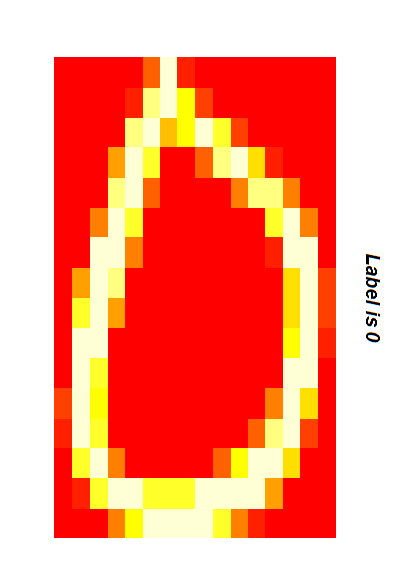
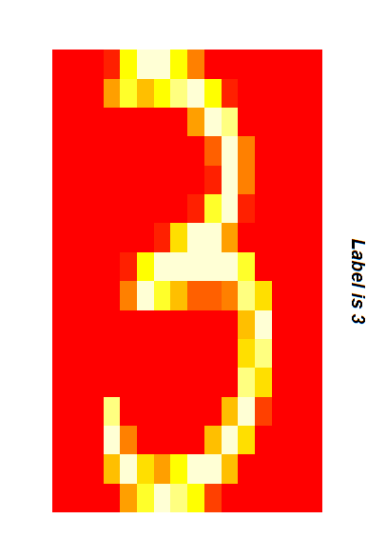
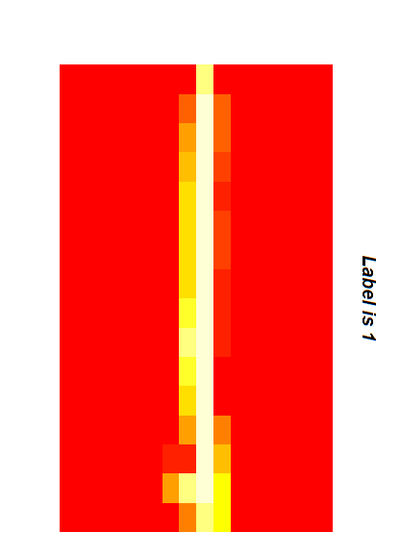
Output: Digit Recognition using SVM

Slide 61
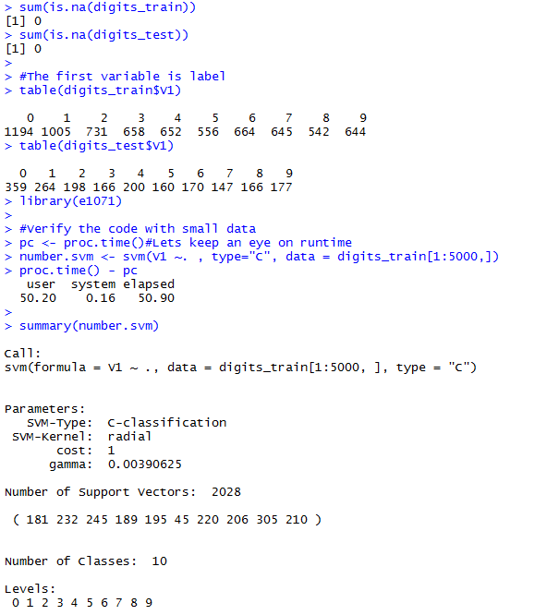
Output: Digit Recognition using SVM

Slide 62
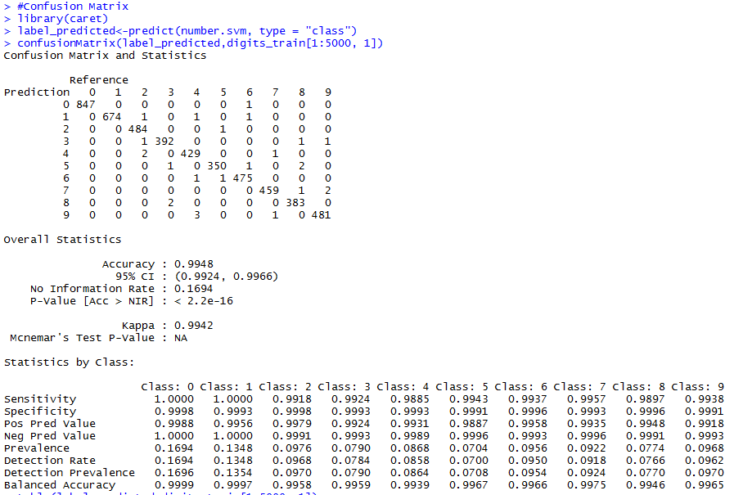
Output: Digit Recognition using SVM

Slide 63
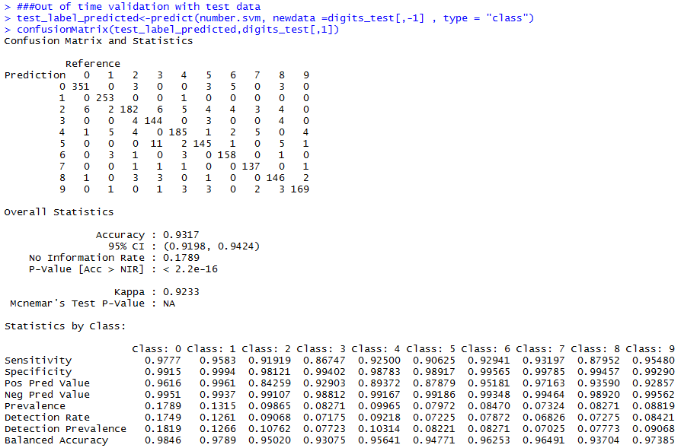
Output: Digit Recognition using SVM

Slide 64
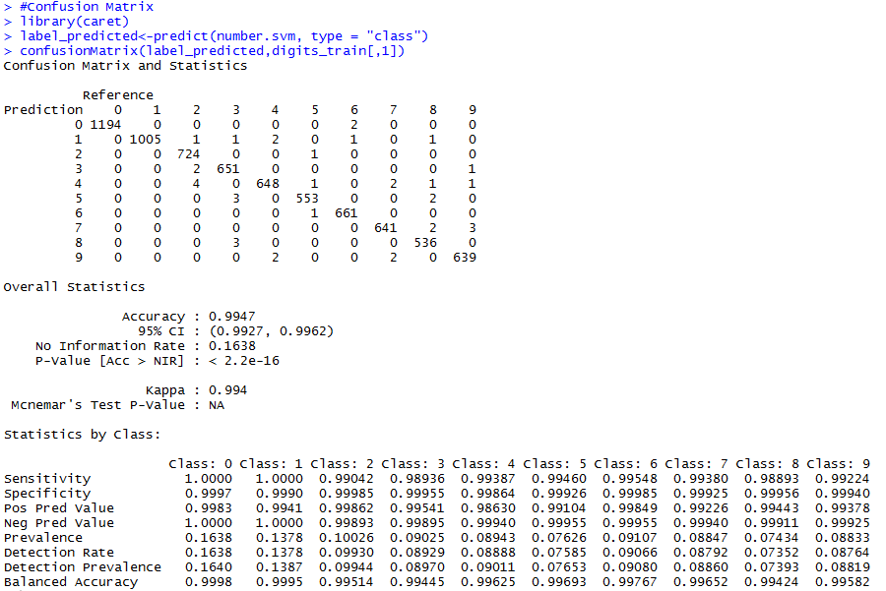
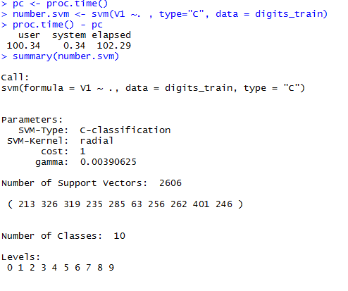
Output: Digit Recognition using SVM

Slide 65
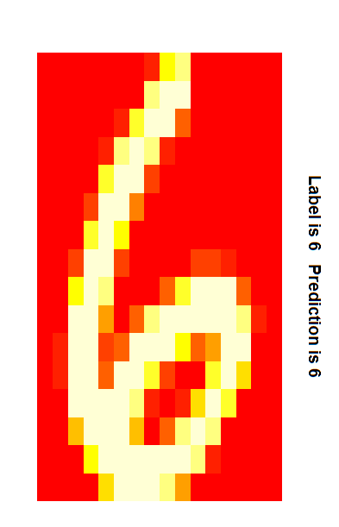
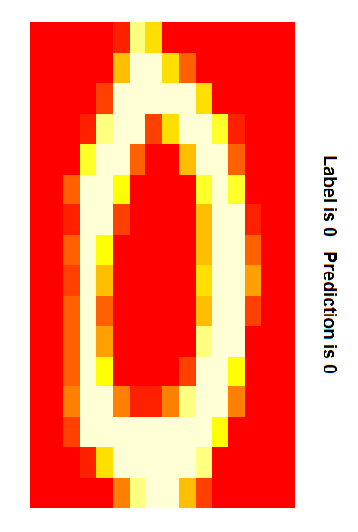
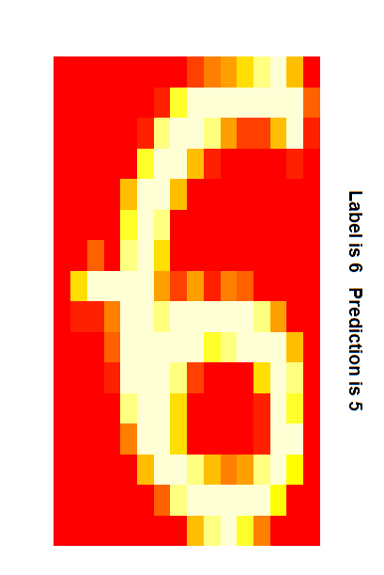
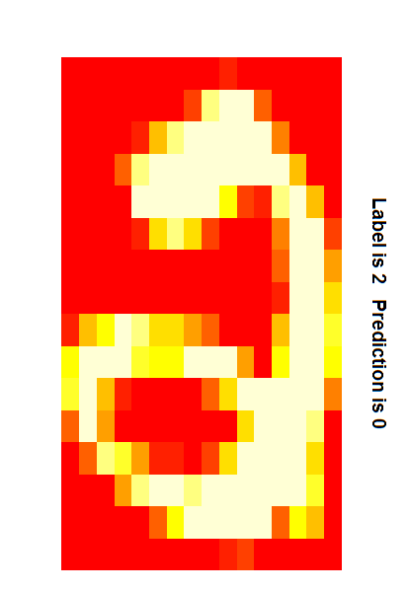
Output: Digit Recognition using SVM

Slide 66
Conclusion

Slide 67
Conclusion
Many software tools are available for SVM implementation
SVMs are really good for text classification
SVMs are good at finding the best linear separator. The kernel trick makes SVMs non- linear learning algorithms
Choosing a appropriate kernel is the key for good SVM and choosing the right kernel
function is not easy
We need to be patient while building SVMs on large datasets. They take a lot of time for training.

